Slide 1

ONLINE FOOD DELIVERY DATABASE For HINF 6220 Database Design, Access, Modeling and Security
Tushar Rathod
Northeastern University, Boston

Slide 2
Contents
Introduction
Model Walkthrough
Normalization
Queries
Lessons Learnt
Limitations

Slide 3
Introduction
A service-based online food delivery company uses real-time data, administers a sizable database, and relies on maximum orders as a source of profit.
Customers interact with the restaurant directly using an app that allows them to order from their preferred restaurants wherever they are.
Fast deliveries with the highest levels of customer satisfaction are the restaurant’s and application’s main priorities.
The app registers customer feedback for every order so it can focus on customers, restaurants, and deliveries for quality purposes.

Slide 4
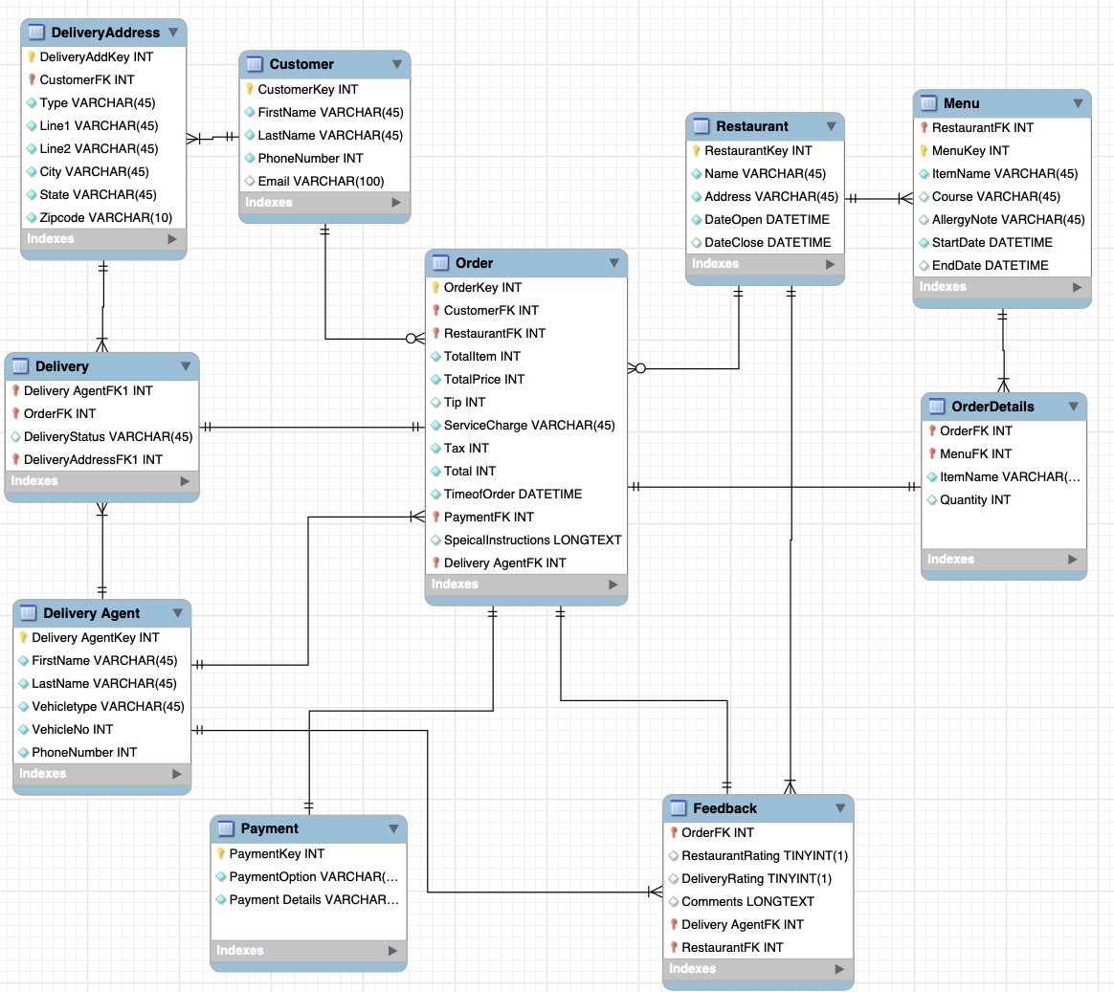
EER DIAGRAM

Slide 5
NORMALIZATIONS AND SPECIALIZATIONS

Slide 6
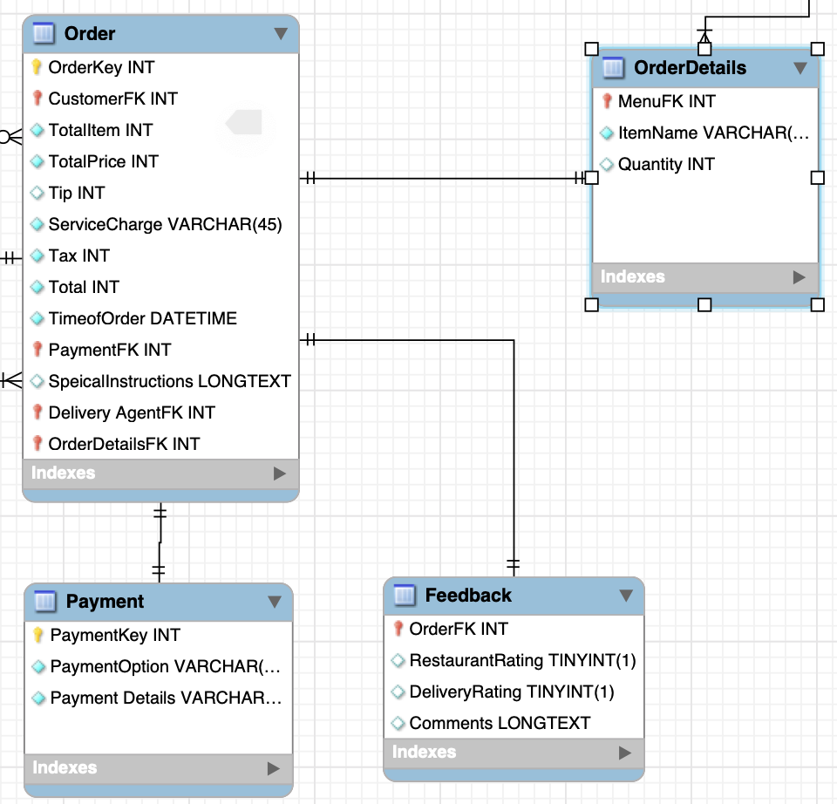
Central Entity
Order is the central entity.
It is the most important entity as the whole database depends on the customer placing an order via the application to the restaurant.
Once the customer places an order, the whole chain process starts.
This database cannot exist without the event of an order taking place.

Slide 7
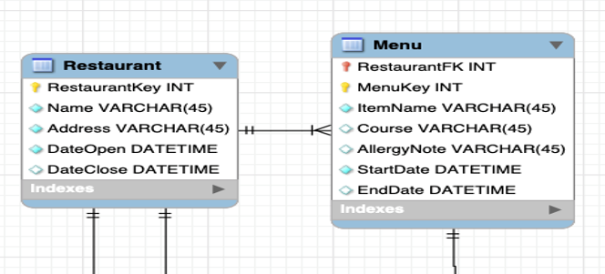
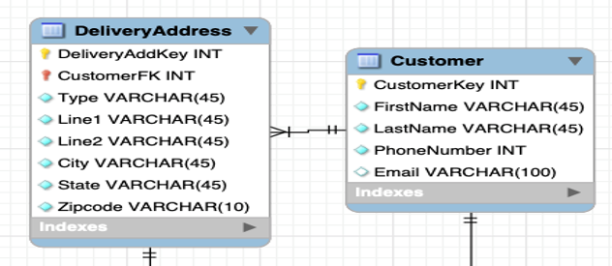
First Specialization
Separate tables for supertype and Subtypes
Restaurant has Menu as subtype table.
Customer has Customer Address as subtype table.

Slide 8
Second Specialization
One table allows nulls for attributes or relationships for each subtype.
Orders have 3 subtypes: payment, feedback, and order details, which can have null attributes.

Slide 9
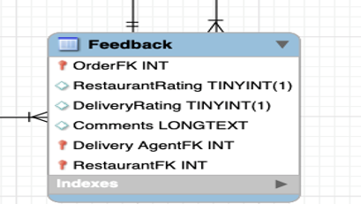
Third Specialization
One table – For feedback that includes rating for restaurants and delivery agents

Slide 10
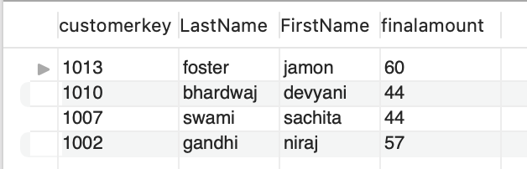
Queries
Report 1. Find the customers who have an order value greater than the average order value.
Query:
SELECT c.customerkey,
c.LastName,
c.FirstName,
o.finalamount
FROM customer c
JOIN orders o
ON c.CustomerKey = o.CustomerKey
JOIN (SELECT c.CustomerKey,
AVG (finalamount) AS AverageOrderValue
FROM customer c
JOIN orders o
ON c.CustomerKey = o.CustomerKey
GROUP BY c.CustomerKey) a1
ON c.CustomerKey = a1.CustomerKey
WHERE o.FinalAmount > a1.AverageOrderValue;

Slide 11
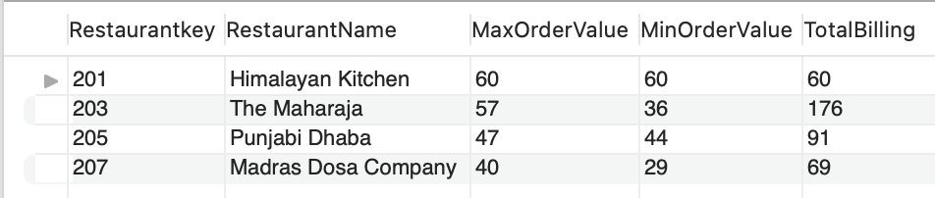
Query 2
Report 2: what is the maximum and minimum order value at each restaurant?
Query:
SELECT r.Restaurantkey,
r.RestaurantName ,
MAX(FinalAmount) as MaxOrderValue,
MIN(FinalAmount) as MinOrderValue,
SUM(FinalAmount) as TotalBilling
FROM orders o
JOIN restaurant r
ON o.restaurantkey = r.restaurantkey
GROUP BY o.Restaurantkey;

Slide 12
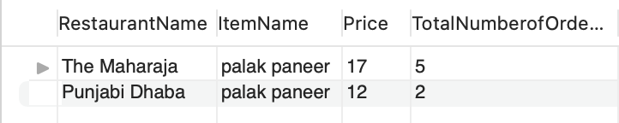
QUERY 3
Report 3: Which restaurants serve palak paneer and find the number of times it has been ordered. Find its price at each restaurant.
Query:
SELECT r.RestaurantName,
m.ItemName,
m.Price,
SUM (od.Quantity) AS TotalNumberofOrders
FROM Menu m
JOIN orderdetails od
ON m.menukey = od.menukey
JOIN Restaurant r
ON m.restaurantkey = r.restaurantkey
Where m.ItemName = 'palak paneer'
Group By r.restaurantkey ;

Slide 13
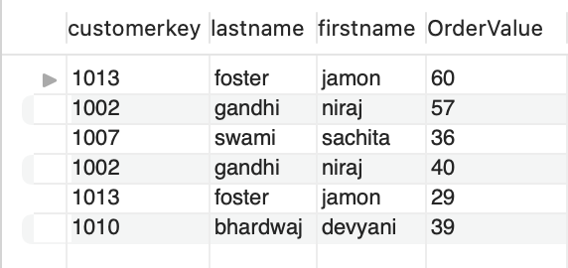
QUERY 4
Report 4: Find the customers who have order values less than or equal to 40 and more than or equal to 50.
Query:
SELECT c.customerkey,
c.lastname,
c.firstname,
o.Finalamount as 'OrderValue'
FROM customer c
JOIN orders o
ON c.customerkey = o.customerkey
WHERE o.finalamount >=50
UNION
SELECT c.customerkey,
c.lastname,
c.firstname,
o.Finalamount as 'OrderValue’
FROM customer c
JOIN orders o
ON c.customerkey = o.customerkey
WHERE o.finalamount <=40;

Slide 14
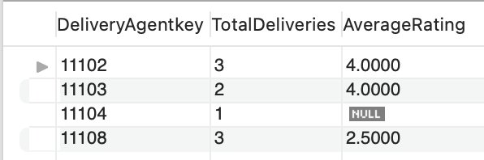
QUERY 5
Report 5: Total number of deliveries by delivery agents and their avg rating.
Query:
SELECT d.DeliveryAgentkey,
COUNT(d.Orderkey) as TotalDeliveries,
AVG(f.DeliveryRating) as AverageRating
FROM delivery d
LEFT JOIN feedback f
ON d.orderkey = f.orderkey
GROUP BY DeliveryAgentkey;

Slide 15
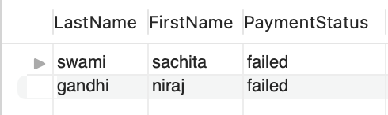
QUERY 6
Report 6: Find the customers that had failed payment status.
Query:
SELECT c.LastName,
c.FirstName,
PaymentDetails AS 'PaymentStatus'
FROM customer c
JOIN orders o
ON c.CustomerKey = o.Customerkey
JOIN payment p
ON o.Paymentkey = p.PaymentKey
WHERE PaymentDetails = 'failed';

Slide 16
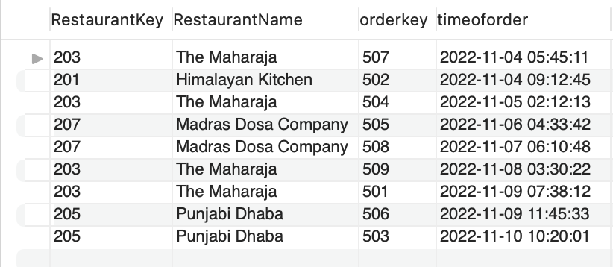
QUERY 7
Report 7: Find the number of orders placed at restaurant during November 03 to November 11.
Query:
SELECT DISTINCT r.RestaurantKey,
r.RestaurantName,
o.orderkey,
o.timeoforder
FROM restaurant r
JOIN orders o
ON r.restaurantkey=o.restaurantkey
WHERE o.timeoforder
BETWEEN '2022-11-03' AND '2022-11-11'
ORDER BY o.timeoforder ASC;

Slide 17
Lessons Learnt
Specialization and Generalization
Planning for the model with including 3 types of specialization.
Use of identifying and non-identifying relationship
The difference in Primary-key and Foreign-key in entities for identifying and non-identifying relationships.
Parent-child table relationship
No need of using the different primary keys for each entity, for example, the customer key, delivery agent key, payment key, and restaurant key acts as the foreign key in the center order table.
Forward Engineering
It is important to select proper Data type for each column.

Slide 18
Limitations
Feedback
Feedback has options related to the food quality and quantity, not based on the customer’s opinion of the restaurant, delivery time, and delivery agent behavior.
Delivery
Delivery has only one data point of delivery success, which is not including enroute, and cancelled.
Customer
The customer’s social media accounts have not been linked.

Slide 19
Thank You!
Questions?

